Slide 1
Credit-card-approval-prediction-classification
- Parikshith ts

Slide 2
PROBLEM STATEMENT:
Banks receive a lot of credit card applications. Many of the applications do not get approved for a variety of reasons, like poor-income levels etc. Manually analyzing these applications can be very time-consuming and full of human errors
The task of predicting whether a credit card application will be approved or rejected based on values of feature variables is a supervised machine learning classification task.
We here automated this process by applying machine learning techniques .here we need to make sure to target
the right customer
This dataset is interesting because there is a good mix of attributes – continuous, nominal with small numbers of values, and nominal with larger numbers of values. There are also a few missing values.

Slide 3
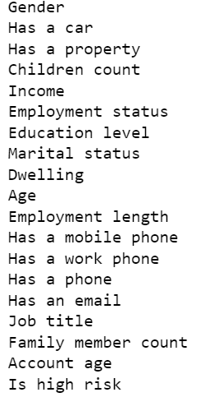
Overview
For this project an credit card approval data set named credit card approval prediction has been picked which available on commercial banks websites
the data contain records of 29165 customer details.
Independent variables
Dependent Variables

Slide 4
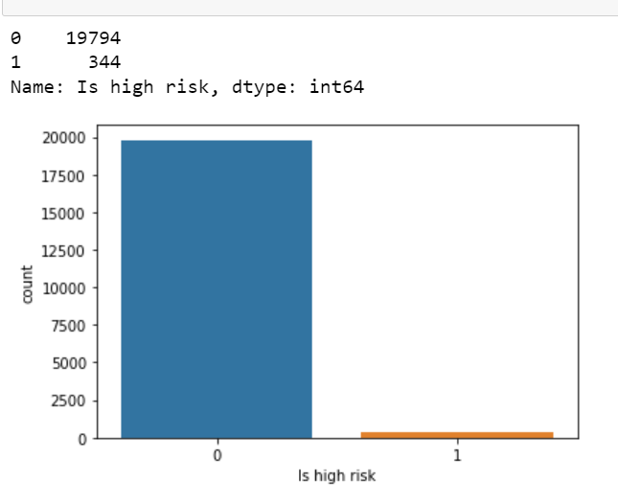
Dataset overview
in this count plot you can see major difference between credit card application approved and not approved
This indicates probability of getting the credit card request not approved is much higher
1= Approved
0= Not Approved

Slide 5
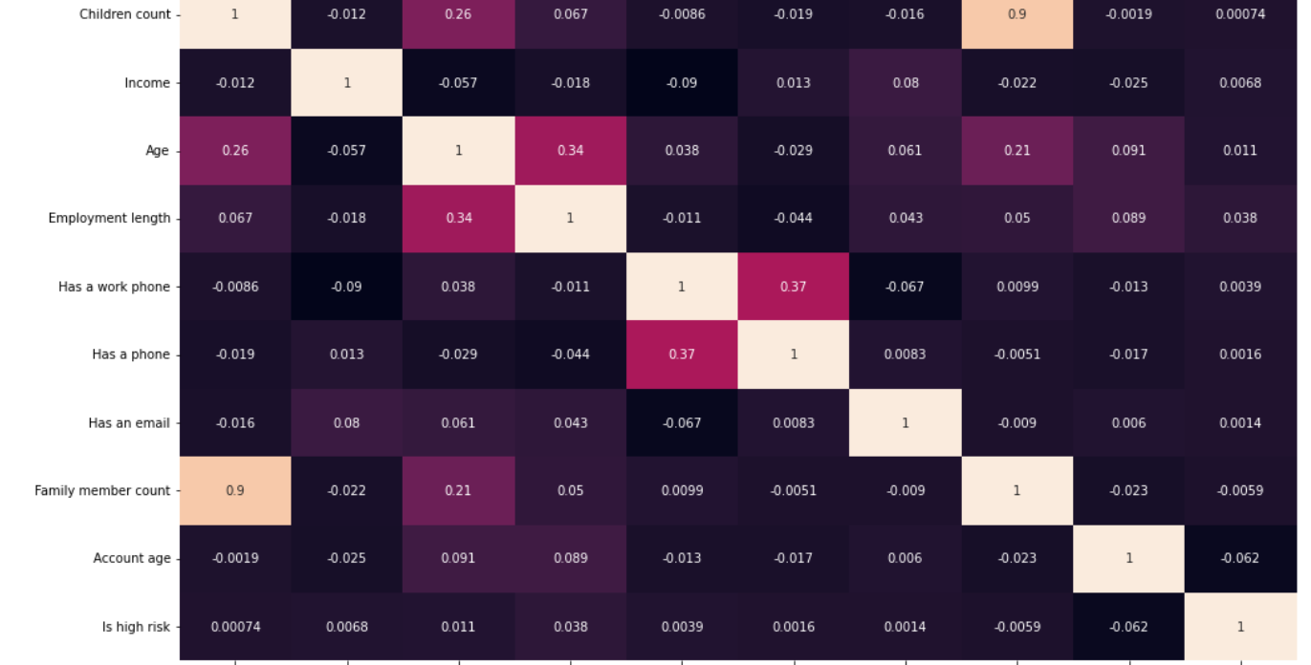
Correlation
The corr() method will give a matrix with the correlation values between each variable
The dark color shows the high correlation between the variables and the light colors shows less correlation between the variables
If 2 columns are highly correlated(lets say: more than 98% )we can remove that column

Slide 6
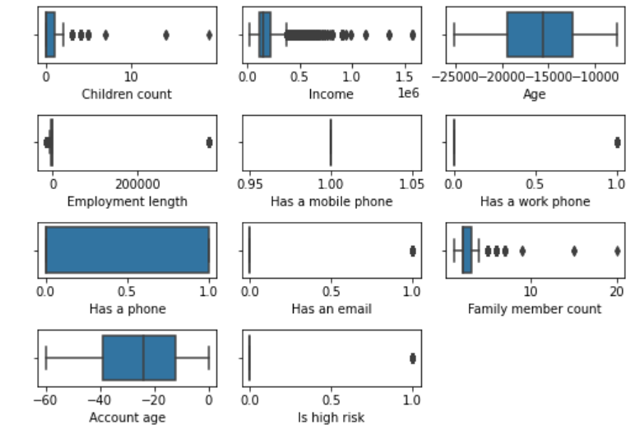
Handling outliers
Presence of outliers may cause problems during model fitting and may also result in inflated error metrics which give higher weights to large errors. Hence, it is necessary to treat outliers before building a machine learning model.
Here I was used IQR method to remove the outliers because of data is skewed
compute lower bound = (Q1–1.5*IQR),upper bound = (Q3+1.5*IQR)
Sort the dataset in ascending order
calculate the 1st and 3rd quartiles(Q1, Q3)
compute IQR=Q3-Q1

Slide 7
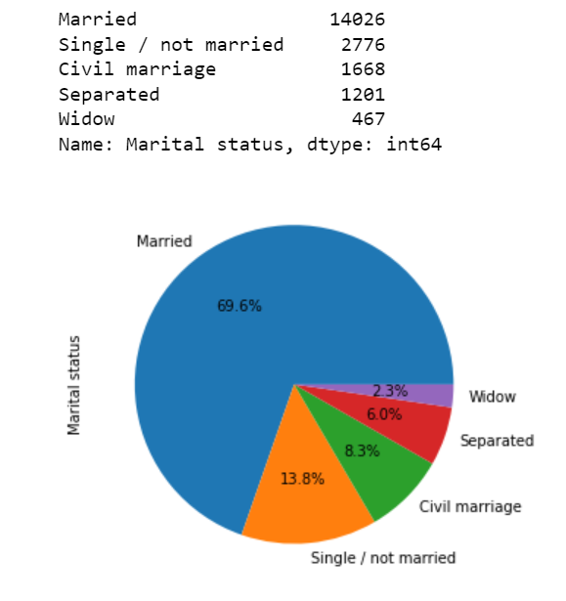
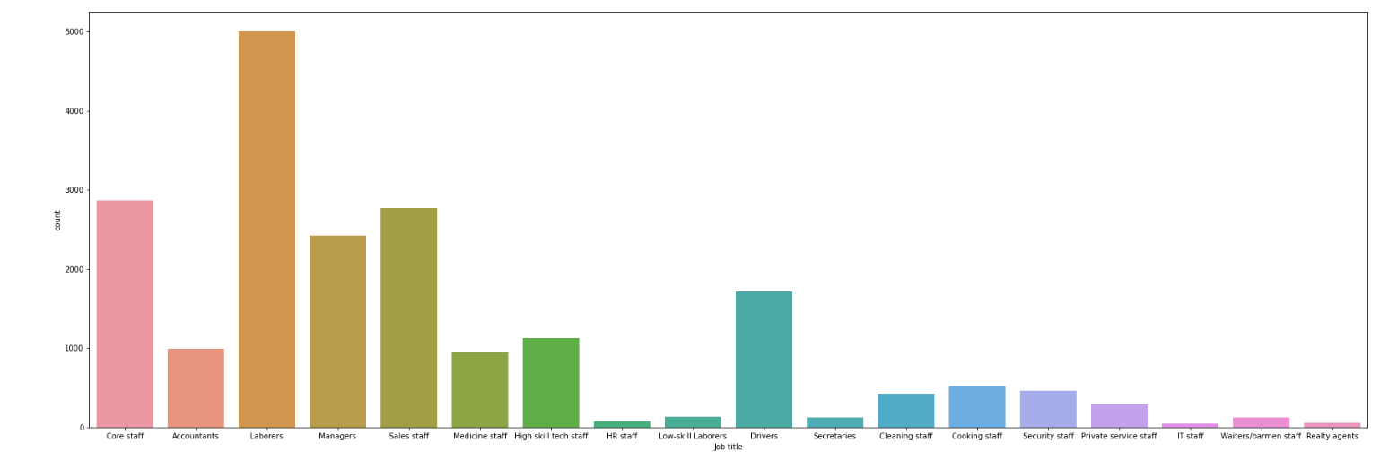
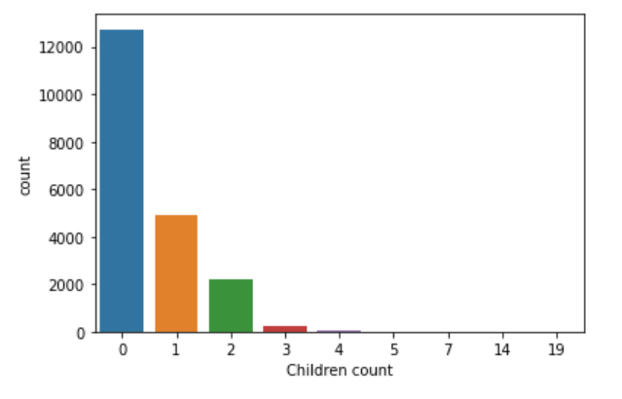
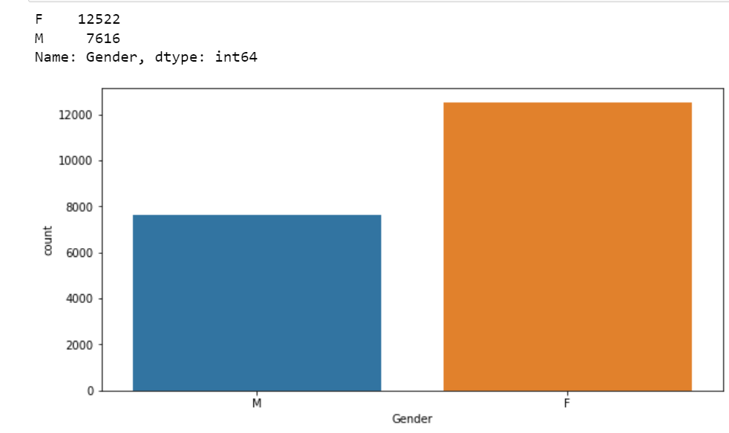
The dataset repository contains a mix of both approved and non-approved .
In this data set most of applicants are working married Female with a partner and no child

Slide 8
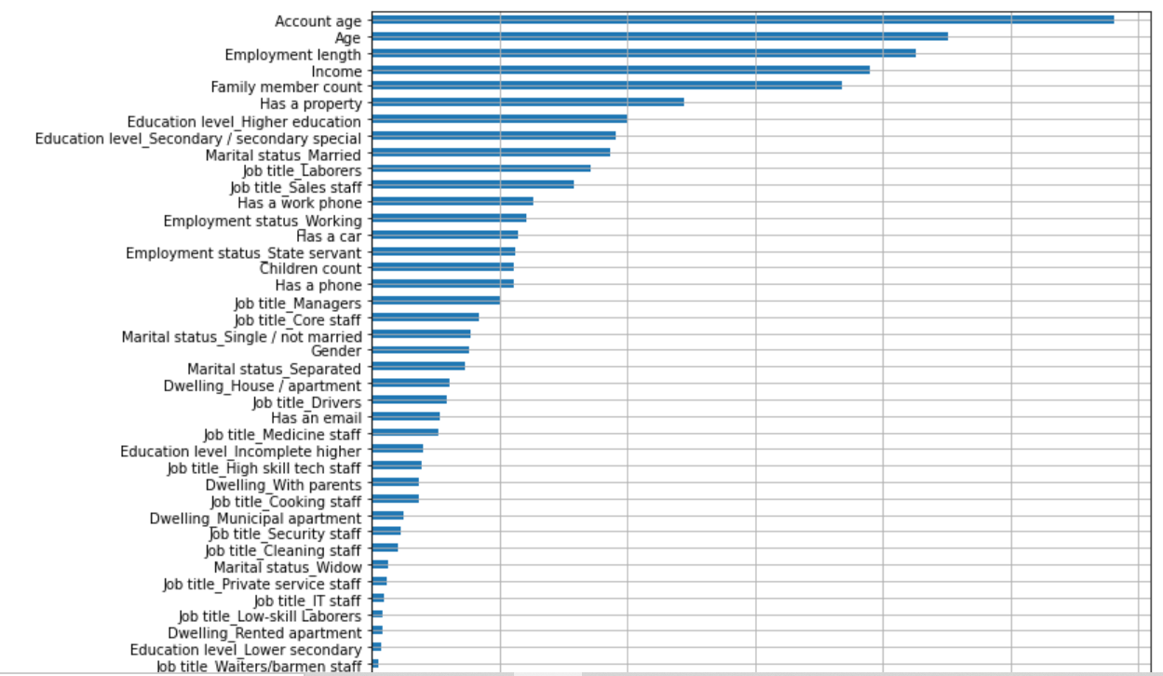
Features ranked on the basis of their importance

Slide 9
Data Preprocessing
Data set is divided in 80:20 ration for train and test respectively.
ID column was dropped its unnecessary for our model
No null values in this dataset
Standardization: It is a very effective technique which re-scales a feature value so that it has distribution with 0 mean value and variance equals to 1.
SMOTE (synthetic minority oversampling technique) is one of the most commonly used oversampling methods to solve the imbalance problem. It aims to balance class distribution by randomly increasing minority class examples by replicating them.

Slide 10
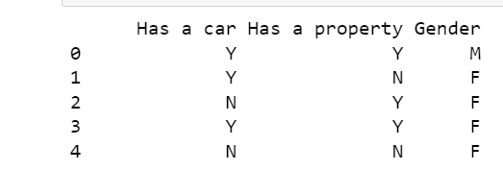
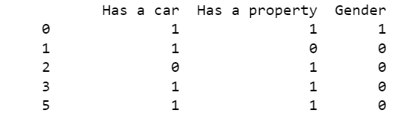
Label encoding
converting the labels into a numeric form so as to convert them into the machine-readable form . It is an important pre-processing step for the structured dataset in supervised learning.

Slide 11
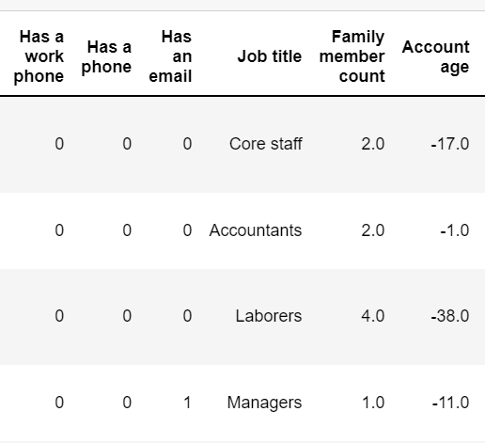
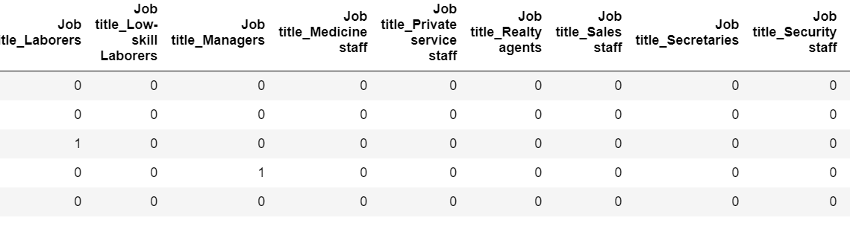
One hot-encoding
The process in which Categorical variable are converted into a form ,where we can apply algorithms to do prediction easily

Slide 12
Different Models
sl.no | Model | Auc_ score | precision | Recall | Accuracy | F1_score | Kappa score | Confusion matrix
01 | Logistic_ regression | 0.57123 | 0.561572 | 0,649659 | 0.57123 | 0.602412 | 0.14246 | [1951,2008 1387,2572]
02 | XGB classifiers | 0.991538 | 0.992409 | 0.990654 | 0.991538 | 0.99151 | 0.983077 | [3924,19 35,3921]
03 | Randomforest | 0.88002 | 0.9199 | 0.832533 | 0.8802 | 0.874039 | 0.76004 | [3672,287 664,3295]
04 | SVC | 0.529048 | 0.532413 | 0.477141 | 0.529048 | 0.503264 | 0.058096 | [2300,1659 2070,1889]
05 | Ada_boost | 0.864107 | 0.870661 | 0.855266 | 0.864107 | 0.862895 | 0.728214 | [3456,503 574,3385]
06 | Decision tree | 0.979919 | 0.97387 | 0.982571 | 0.979919 | 0.979972 | 0.979972 | [3869,90 69,3890]

Slide 13
Proposed Model
XG Boost( Extreme Gradient Boosting)
It is used for binary classification
XGBoost belongs to a family of boosting algorithms that convert weak learners into strong learners
Out put have a nice probabilistic interpretation, and the algorithm can be regularized to avoid over fitting gradient boosted
it is a sequential process trees are grown using the information from a previously grown tree one after the other, iteratively the errors of the previous model are corrected by the next predictor.
Advantages:
Regularization
Tree pruning
High Flexibility

Slide 14
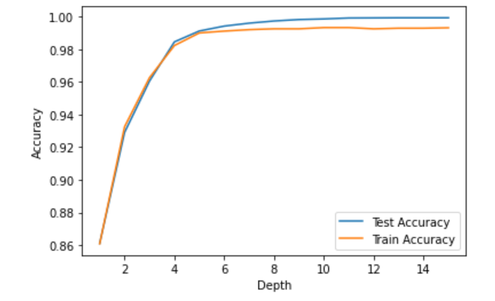
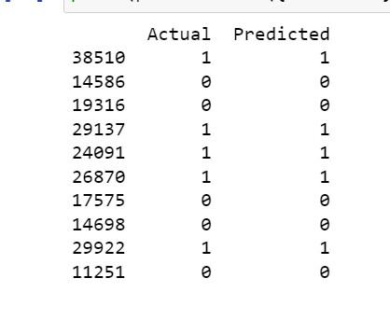
testing and training accuracy
graph depicts the variation of testing and training accuracy according to depths.

Slide 15
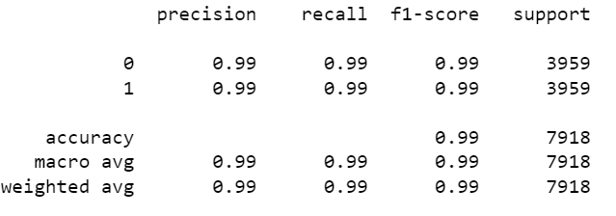
Evaluation Process
Evaluation metrics:
Accuracy: determine the how often the model predicts application approved or not
Precision: it calculates whenever our model predict values how often it is correct
Recall: Recall regulate the actual value that the model is actual predict
Roc Curve: a graph showing the performance of a classification model at all classification thresholds.
F1 score: it used compare the performance of two classifiers
Cross Validation
K fold cross validation

Slide 16
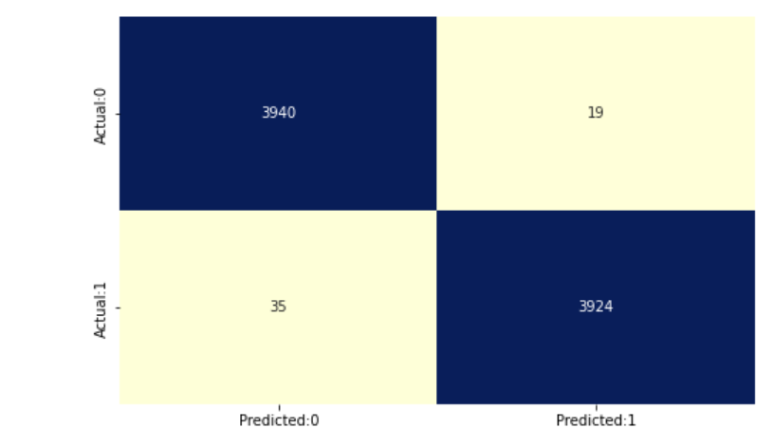
Confusion Matrix
True positive: Application of a person is Approved and predict as Approved
True negative: Application of a person Not approved and predict as Not Approved
False positive: Application of a person not eligible but predicted as approved
False negative: Application of a person eligible but it predicted as not approved

Slide 17
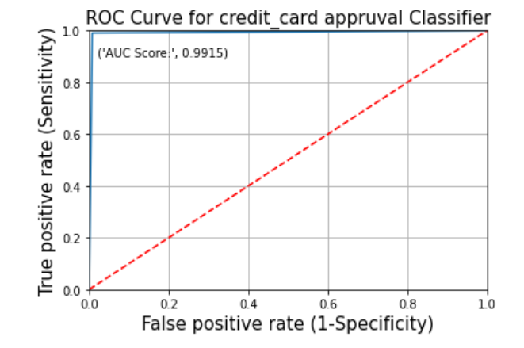
Roc curve
One way to visualize the performance of classification model in machine learning is by creating a ROC curve

Slide 18
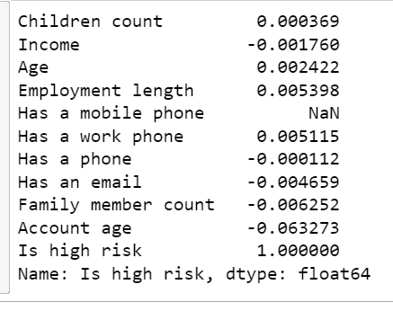
Key findings
Based on the analysis on this project, we found out that income, account age family member count and employment length, are the most predictive features to determine if an applicant will be approved for a credit card or not. Other features like age and working employment status are also useful. The least useful features are: type of dwelling and car ownership.
I was Investigated the data checking for data unbalancing visualizing the feature and understanding the relationship between different feature
I used cross validation to evaluate the model effectiveness to predict the target values
The strongest positive correlations with the target features are:
The strongest negative correlation with the target features are:

Slide 19
How helpful for Business
Credit card approval can very helpful for organizations that lend credit cards and due to increase in huge number of applicants there is need to automate the task and applicants into if they are eligible for credit card or not
Make accurate decisions on managing credit card application
Enterprise Digital Transformation and Business Growth
Here we are not just looking into bank balance but into there personal attributes like gender, married, age, Occupation etc. We account for these personal attributes to evaluate if the given applicant is a good
This helps to avoid organization losses by avoiding the bad customers
This give a benefits by cutting down cost on credit analysis and faster credit decision.

Slide 20
Further improvements
Further model could be more optimized and could give a better accuracy if neural network could be implemented
Also we could be use feature extraction technique to further make a better model.
This project is only for new customers and does not include for the former customers. Instated of We could make this project for former customers also this helps to improve business

Slide 21
Thank you

